Slide 1

I
Composite Pattern
Structural Patterns

Slide 2
Composite Pattern
Intent
Compose objects into tree structures to represent part-whole hierarchies.
Composite lets clients treat individual objects and compositions of objects
uniformly.
Also Known As
Composite

Slide 3
Composite Pattern
Applicability
Use the Composite pattern when:
you want to represent part-whole hierarchies of objects.
you want clients to be able to ignore the difference between compositions of objects and individual objects. Clients will treat all objects in the composite structure uniformly.

Slide 4
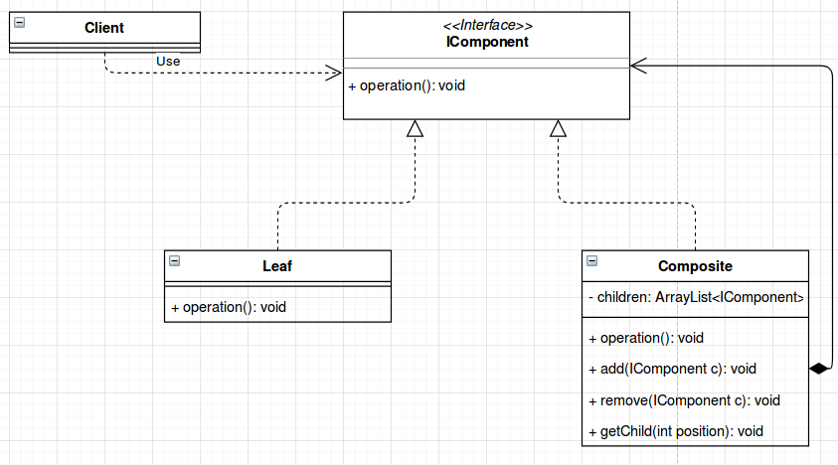
Composite Pattern
Structure

Slide 5
Composite Pattern
Participants
Component (Graphic)
Declares the interface for objects in the composition.
Implements default behavior for the interface common to all classes, as appropriate.
Declares an interface for accessing and managing its child components.
(optional) defines an interface for accessing a component's parent in the recursive structure, and implements it if that's appropriate.
Leaf (Rectangle, Line, Text, etc.)
Represents leaf objects in the composition. A leaf has no children.
Defines behavior for primitive objects in the composition.
Composite (Picture)
Defines behavior for components having children.
Stores child components.
Implements child-related operations in the Component interface.
Client
Manipulates objects in the composition through the Component interface.

Slide 6
Composite Pattern
Collaborations
Related Patterns
Clients use the Component class interface to interact with objects in the composite structure. If the recipient is a Leaf, then the request is handled directly. If the recipient is a Composite, then it usually forwards requests to its child components, possibly performing additional operations before and/or after forwarding.
Chain of responsibility
Decorator
Flyweight
Iterator
Visitor

Slide 7
Composite Pattern
Consequences
Define class hierarchies consisting of primitive objects and composite object. Primitive object ca be composed into more complex objects, which in turn can be compose and so on recursively.
Makes the client simple. Clients can treat composite structure and individual objects uniformly. Clientes normally don’t know(and shouldn’t care) whether they are dealing with a leaf or a composite component.
Makes it easier to add new kinds of components. Newly defined composite or leaf subclasses work automatically with existing structures and client code. Clients don’t have to be changed for new component classes.
Can make your design overly general. The disadvantage of making it easy to ad new components is that it makes it harder to restrict the components of a composite.

Slide 8
Composite Pattern
Known Uses
Examples of the Composite pattern can be found in almost all object-oriented systems.
The original View class of Smalltalk Model/View/Controller [KP88] was a Composite, and nearly every user interface toolkit or framework has followed in its steps, including ET++ (with its VObjects [WGM88]) and InterViews (Styles [LCI+92], Graphics [VL88], and Glyphs [CL90]).
The RTL Smalltalk compiler framework [JML92] uses the Composite pattern extensively. RTLExpression is a Component class for parse trees. It has subclasses, such as BinaryExpression, that contain child RTLExpression objects.
Another example of this pattern occurs in the financial domain, where a portfolio aggregates individual assets. You can support complex aggregations of assets by implementing a portfolio as a Composite that conforms to the interface of an individual asset [BE93].

